Slide 1

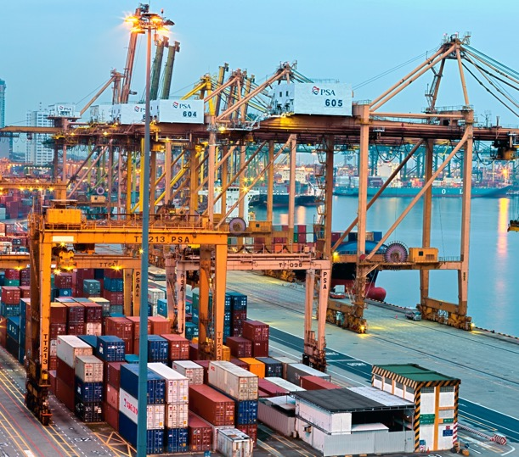
Session 2

Slide 2
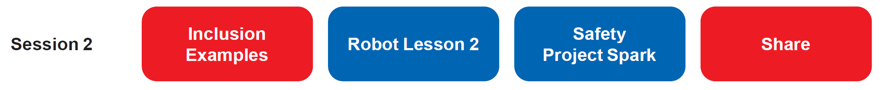
Session Overview
Outcomes
The team will build a driving base and code it to move forward, move backward, and turn.
The team will make connections from the mission models to the Safety Project Spark ideas.
Notes:
Facilitator Tips
Some of the team may excel at model building and can help others who get stuck. If the team talks over each other, refer them to the team roles and designate one person as the communicator.

Slide 3

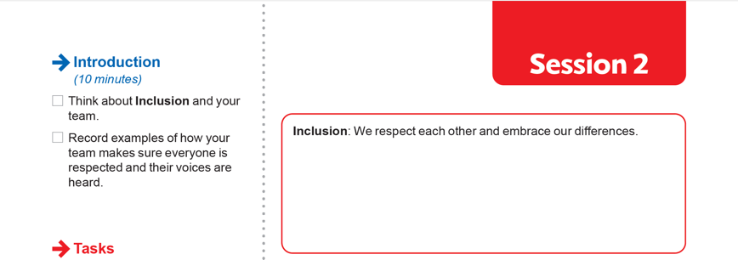
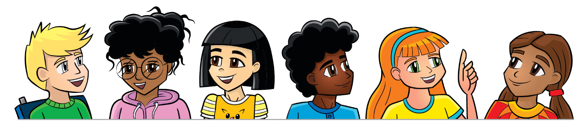
Introduction
Think about Inclusion and your team.
Record examples of how your team makes sure everyone is respected and their voices are heard.
Notes:
Facilitator Tips
At the tournament judging session, the team will provide examples of how they have used Core Values, so there are introduction activities for them to practice this.

Slide 4
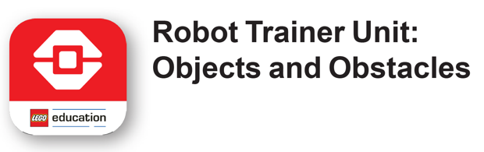

Robot Lesson 2
Open the SPIKE™ Prime or EV3 Classroom app. Find your lesson.
Determine what coding and building skills you can apply in the Robot Game.
Notes:
Facilitator Tips
Remind the team to save their programs often on their device.
After a program is downloaded onto the controller, it cannot be transferred back to be opened and edited.
Have the team practice their new skills by trying to drive the robot to a model and then returning to Home.
Robot Game Connection: Have the team code the robot to push an object and deliver it to a target area on the mat.

Slide 5

Robot Lesson 2
Reflection Questions
How can you aim your robot toward a model?
How can you make your robot go the right distance to reach a model?
How does a machine operator safely load and unload cargo?

Slide 6

Safety Project Spark
How does safety affect how cargo is transported?
How can you make transporting cargo safer?
Think about…
People driving different forms of transportation.
Loading and unloading cargo.
Different forms of transportation used to transport cargo.
The infrastructure used in transportation.
The models you built this session relate to missions in the Robot Game that represent improving the safety of transporting cargo.

Slide 7
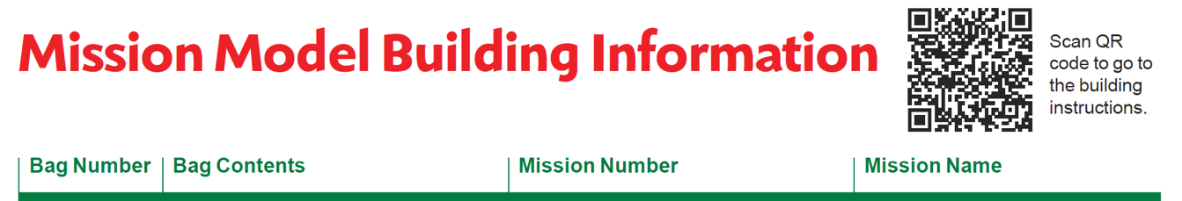
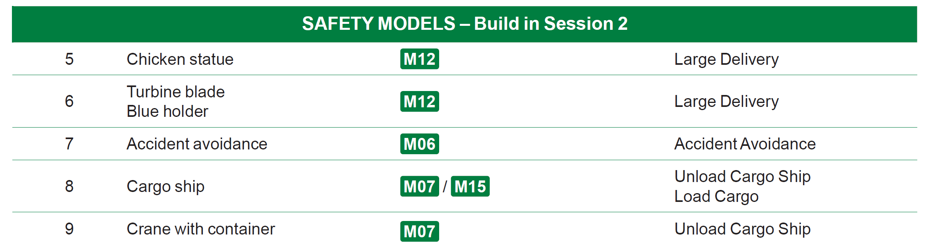
Safety Project Spark
Build the Safety models in Bags 5-9 using Building Instruction Books 5-9.
Notes:
Facilitator Tips
Provide the digital building instructions Books 5-9 to the team. Find them at firstlegoleague.org/ season#resources.
The team will need Bags 5-9 from the Challenge set. Larger pieces may be in an unnumbered LEGO® bag.

Slide 8
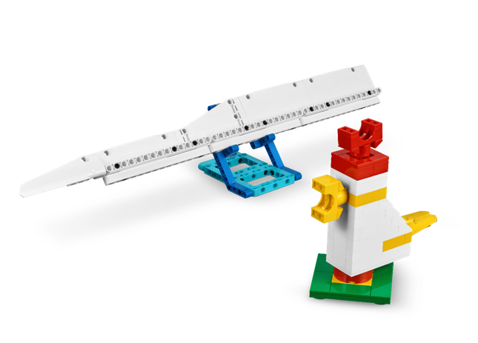
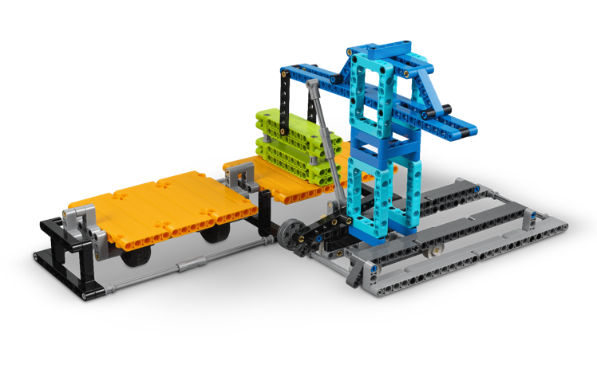
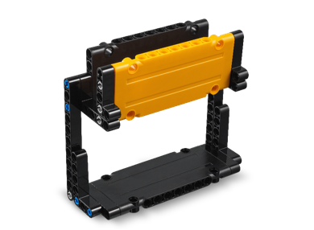
Safety Project Spark
Look over the missions that correspond to the models.
Talk about how the mission models relate to the Project Spark.

Slide 9
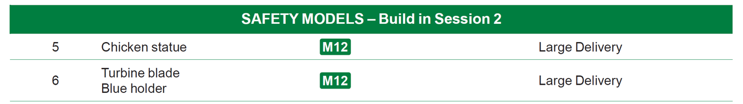

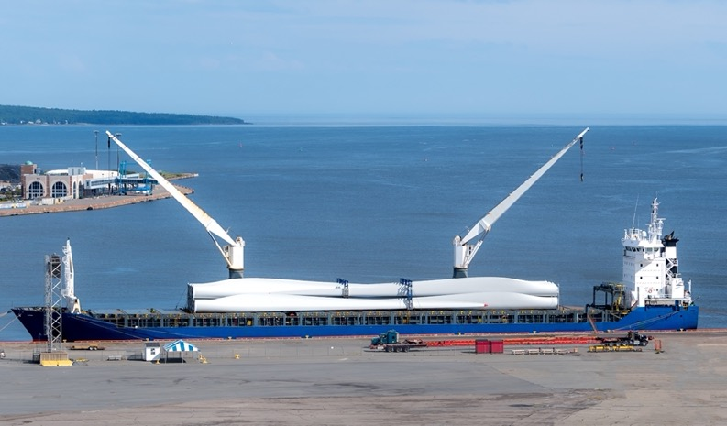
Chicken Statue & Turbine Blade

Slide 10
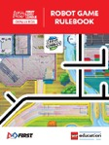
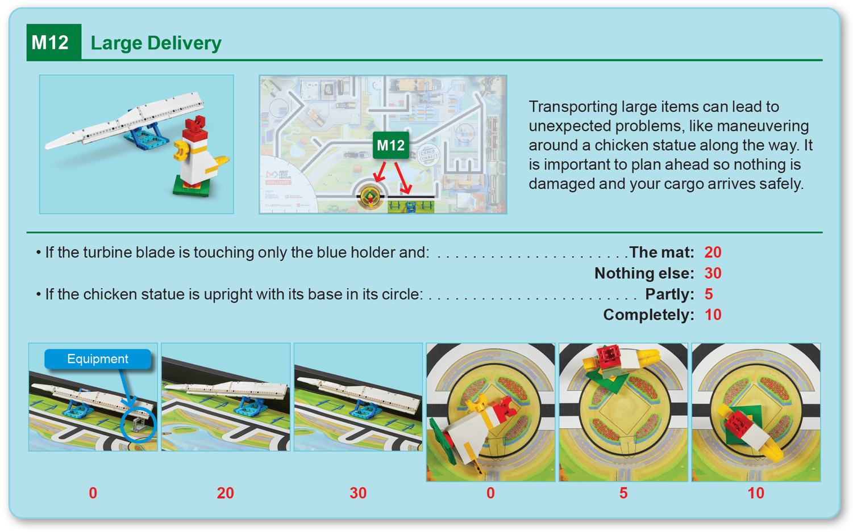
Robot
Game
Rulebook
page 18

Slide 11

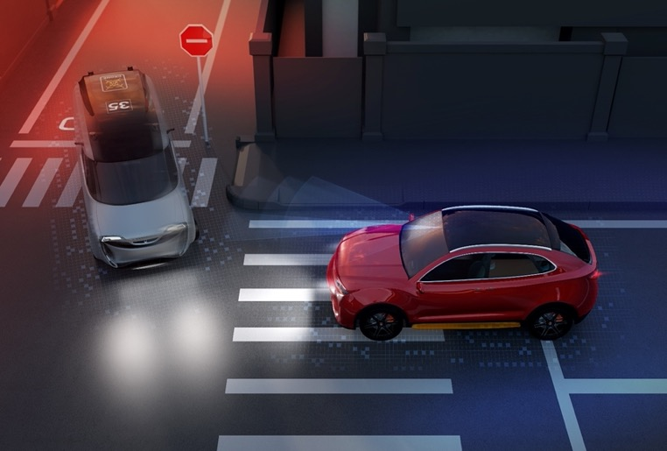
Accident Avoidance

Slide 12
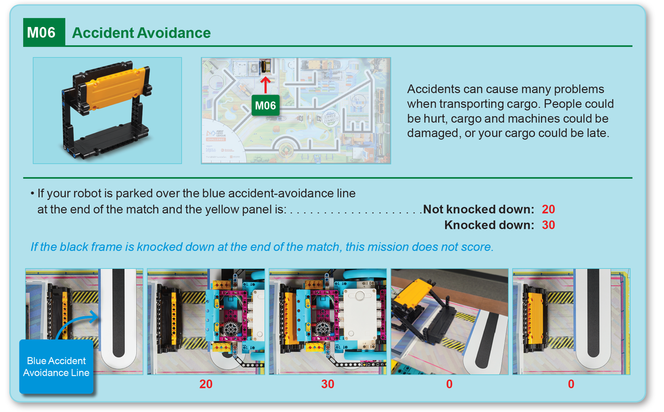
Robot
Game
Rulebook
page 15

Slide 13
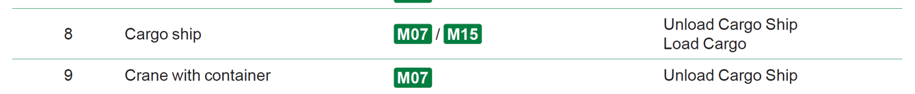
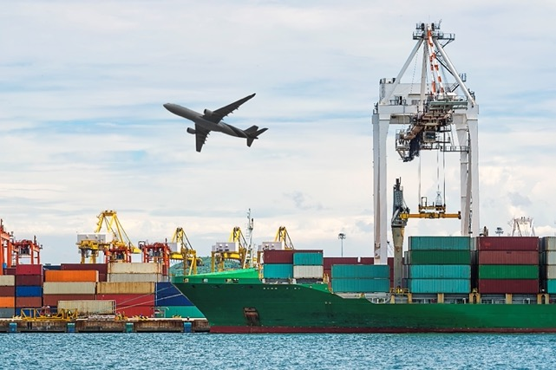
Cargo Ship & Crane with Container

Slide 14
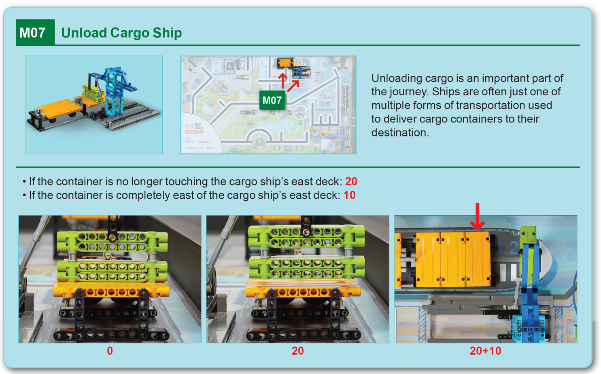
Robot
Game
Rulebook
page 15

Slide 15
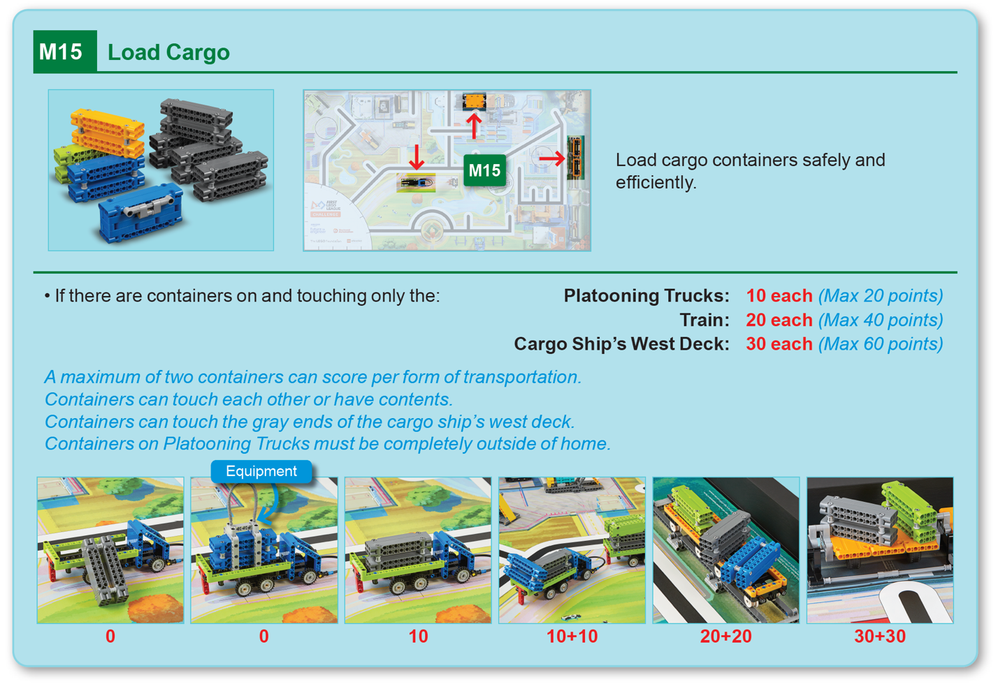
Robot
Game
Rulebook
page 19

Slide 16
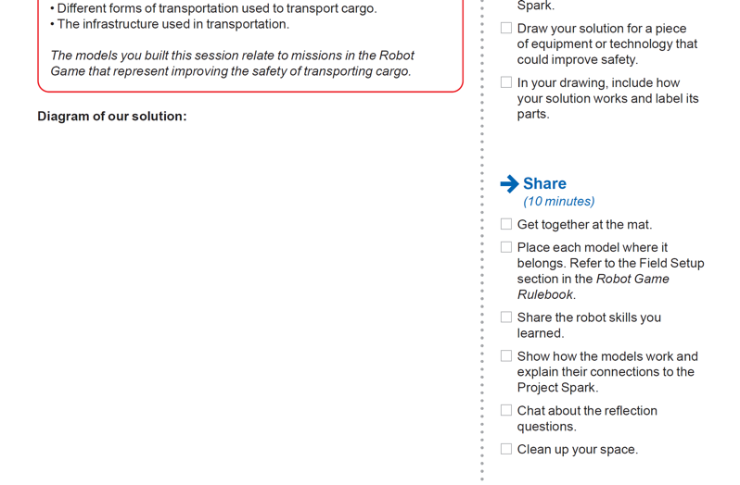
Safety Project Spark
Draw your solution for a piece of equipment or technology that could improve safety.
In your drawing, include how your solution works and label its parts.
Notes:
Facilitator Tips
Have the team think about equipment or technology they could invent as a solution to the Project Spark.
The team can use visual aids to help explain their Innovation Project solution, so this gives them practice at creating a detailed diagram.

Slide 17
Share
Get together at the mat.
Place each model where it belongs. Refer to the Field Setup section in the Robot Game Rulebook.
Share the robot skills you learned.
Show how the models work and explain their connections to the Project Spark.
Chat about the reflection questions.
Clean up your space.

Slide 18
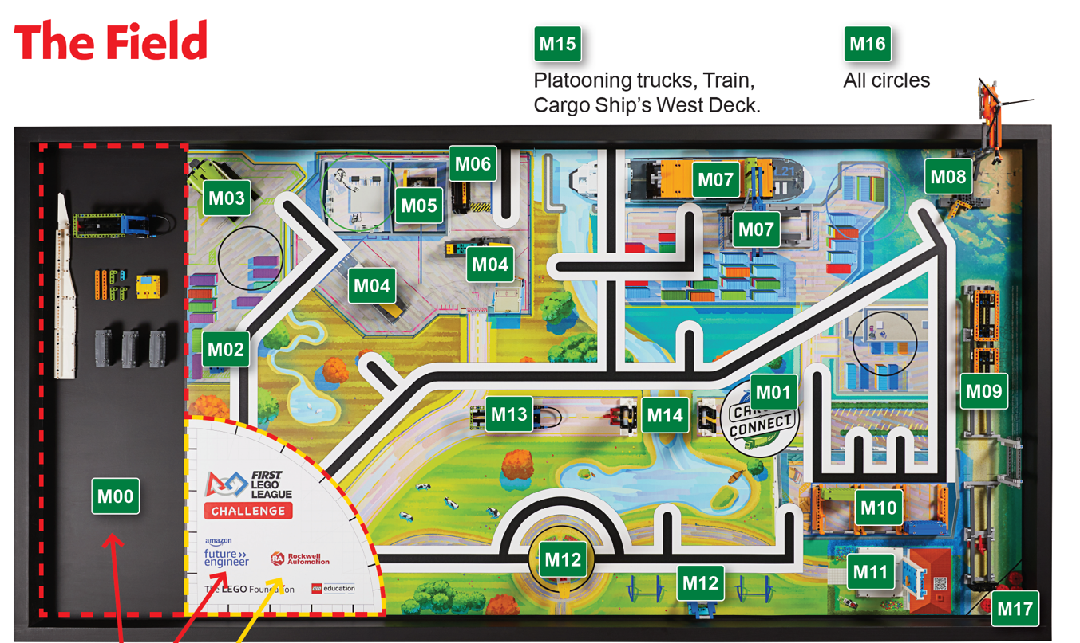
Models built this session are for the circled missions.
Notes:
Place the completed models on the mat with Dual Lock™ according to the field setup in the Robot Game Rulebook.

Slide 19

Reflection Questions
Can you think of interesting ways to safely transport cargo?
What are examples of transportation safety features in your community?
How would a safety specialist do a safety check before transporting large cargo?
Notes:
Facilitator Tips
Check out Career Connections pages in the Engineering Notebook that link to jobs listed in the sessions.

Slide 20
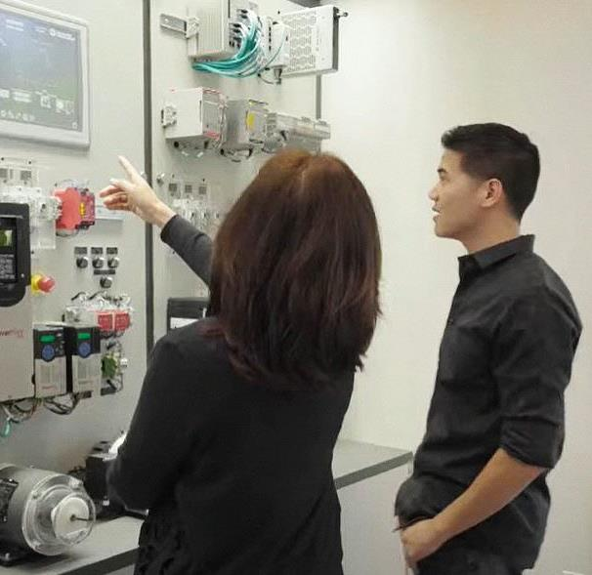
Career Connections
Safety Specialist
Role:
Employs safety practices and ensures compliance.

Slide 21

Multimedia Resources
You may wish to embed a relevant, age-appropriate video for your students here. See the Notes for an example.
Notes:
Choose a relevant, age-appropriate video for your students.
Here is one example: Vestas Wind Turbine Blade Transportation (https://youtu.be/iTpZ5V4HrK4) – Length 2:51

Slide 22
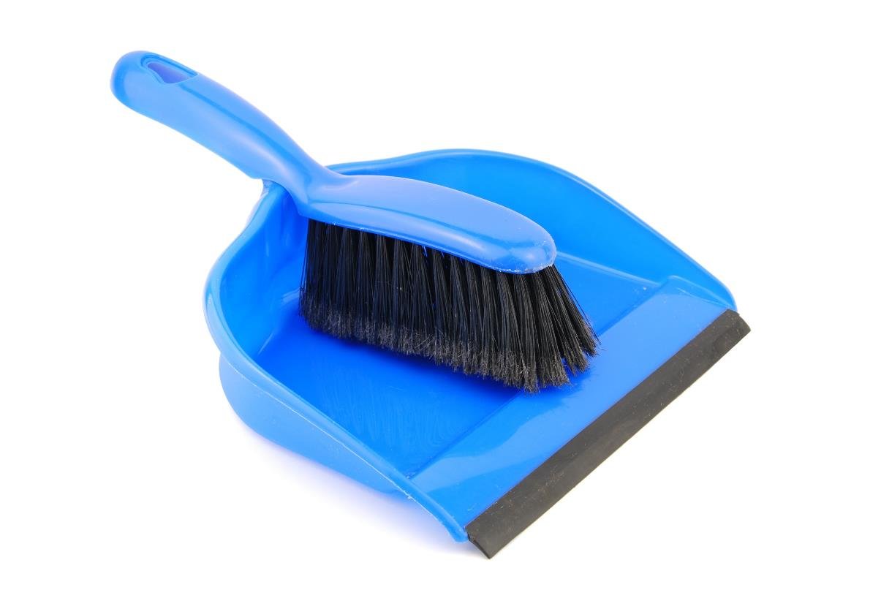
Clean Up

Slide 23

FIRST® and the FIRST® logo are registered trademarks of For Inspiration and Recognition of Science and Technology (FIRST). LEGO® and MINDSTORMS® are registered trademarks of the LEGO Group. FIRST® LEGO® League and CARGO CONNECTSM are jointly held trademarks of FIRST and the LEGO Group. SPIKE™ Prime is a trademark of LEGO® Education. All other trademarks are the property of their respective owners. ©2021 FIRST and the LEGO Group. All rights reserved.

